Slide 1
Independence Day!
Natalia Gray

Slide 2
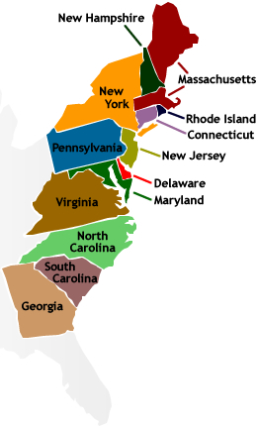
Declaration of Independence
13 Original Colonies
Adopted on July 4th 1776
What did it do?
-Declared that the United States’ 13 original colonies were independent from Great Britain.
Formal document was written by Thomas Jefferson and then signed by the rest of the Founding Fathers such as John Adams, Benjamin Franklin, and Alexander Hamilton

Slide 3
Celebration
Independence Day is known as “America’s Birthday”
Extremely patriotic day, fireworks are set off as a way to celebrate
Red, white, and blue (American flag colors) are worn
The 4th of July is a day to
reflect on the history made in
the United States of America
http://www.youtube.com/watch?v=jx4CDw4hfKc

